Slide 1
ADDITION AND REMOVAL OF ECHO IN AN AUDIO USING MATLAB
DIGITAL SIGNAL PROCESSING
M.MANOJ PRASAMSH KUMAR
URK22EC1025

Slide 2
introduction
Here, we'll explore a Digital Signal Processing (DSP) project focused on echo management in audio signals.
This project aims to simulate and eliminate echo in audio recordings using advanced DSP techniques.
Echo can degrade audio quality and intelligibility, making effective echo management crucial in various applications.
We'll delve into the code developed for echo addition and removal, highlighting key components and methodologies.
Effective echo management is essential in telecommunication, audio recording, and digital communication platforms.

Slide 3
DESCRIPTION
The project involves the development of a user-friendly graphical interface, enabling interactive manipulation of echo parameters and visualization of echo addition and removal effects in real-time.
In this phase, echo effects are simulated by introducing delayed and scaled versions of the original audio signal.
Utilizing advanced DSP techniques such as Finite Impulse Response (FIR) filtering and adaptive algorithms, this phase focuses on attenuating echo components while preserving the integrity of the original audio signal.

Slide 4
CONCEPTS
Sampling refers to the process of converting continuous-time signals into discrete-time signals by measuring the amplitude of the signal at regular intervals.
Quantization involves representing the sampled values with a finite number of bits, which determines the resolution or precision of the digital representation.
FIR filters are often preferred for their linear phase response and stability.
Echo cancellation is a DSP technique used to remove unwanted echoes or reverberations from audio signals.
GUI design involves creating visual interfaces that allow users to interact with DSP algorithms and adjust parameters intuitively.
Real-time signal processing refers to the processing of signals with minimal delay, enabling immediate feedback or response.

Slide 5
FLOWCHART
Start - Load Audio File & Read audio file
Extract input audio and sampling frequency (Fs)
Initialize Echo Parameters
Set initial values for delay, gain, cutoff frequency, and filter order
Add Echo
Compute echoed audio by adding delayed and scaled versions of input audio
Remove Echo (FIR Filter)
Design FIR filter based on cutoff frequency and filter order
Apply FIR filter to echoed audio to remove echo
Create GUI
Initialize GUI window
Plot original, echoed, and de-echoed audio waveforms
Add sliders and buttons for user interaction
Update Echo Parameters (Callback)
Update corresponding plots in GUI
Play Audio (Button Callback)
Play original, echoed, or de-echoed audio when respective button is clicked
End

Slide 6
WORKING
Load Audio: The code loads an audio file and extracts the audio data and sampling frequency.
Echo Simulation: It adds echo to the audio by delaying and scaling the input signal.
Echo Removal: A FIR filter is applied to remove the echo from the echoed audio signal.
GUI Creation: A graphical interface is created with plots for original, echoed, and de-echoed audio waveforms.
User Interaction: Sliders allow users to adjust echo parameters, while buttons enable playback of the original, echoed, and de-echoed audio.
Real-time Updates: Callback functions update echo parameters and audio signals in real-time based on user input.
Audio Playback: Users can listen to the audio signals with or without echo through the GUI.

Slide 7
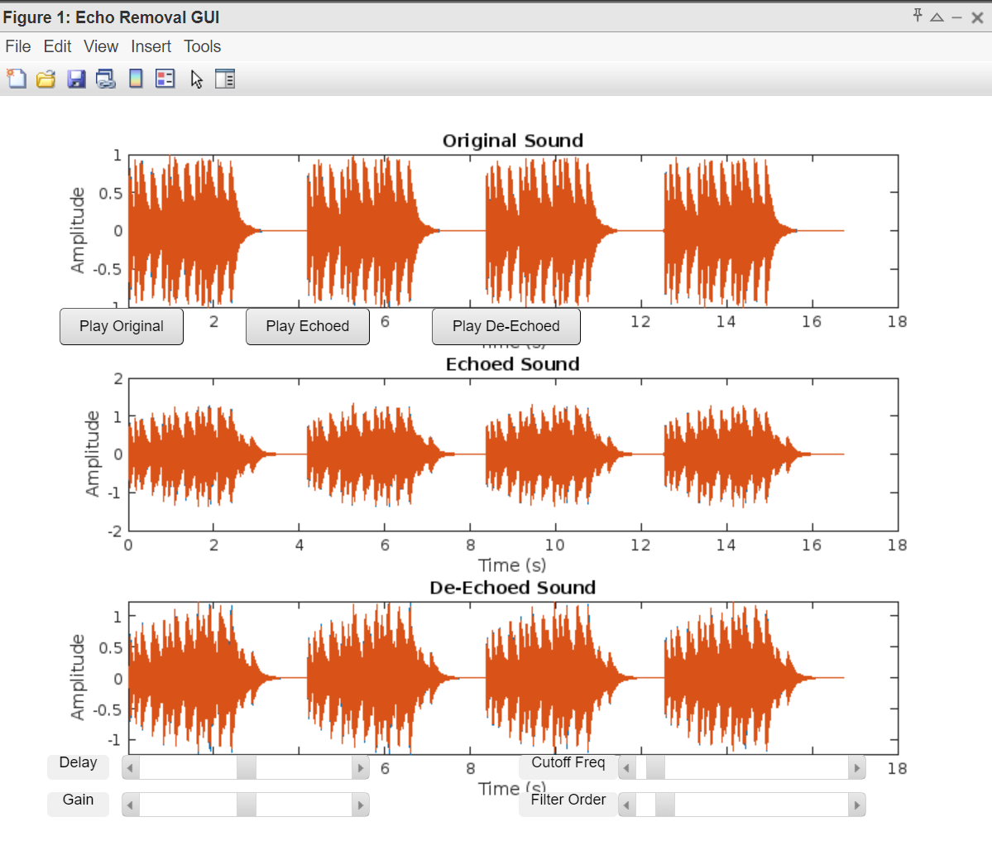
OUTPUT

Slide 8
CONCLUSION
The provided MATLAB code presents a comprehensive solution for echo removal in audio signals through an interactive graphical user interface (GUI).
By leveraging digital signal processing techniques, users can simulate echo effects, adjust parameters in real-time, and listen to the resulting audio with or without echo.
Offers a practical tool for enhancing audio quality in various applications, from telecommunication systems to audio recording studios.
The code underscores the significance of DSP in improving audio communication and user experience.

Slide 9
THANK YOU

